Slide 1
Non-Commercial Stakeholders Group
An Introduction and Guide to ICANN 62
14 June 2018

Slide 2
The Non-Commercial Stakeholder(s) Group
Non-Commercial Stakeholder Group (NCSG)
The NCSG is the home in the Generic Names Supporting Organization (GNSO) for civil society organizations, non-profit organizations, public interest groups, and individuals who are primarily concerned with the non-commercial, public interest aspects of domain name policy.
NCSG also represents non-commercial interests in other ICANN processes, for example structural and organizational reviews, cross-community working groups (CCWG) (NCUC and NPOC as well as unaffiliated members may also often participate in these activities).

Slide 3
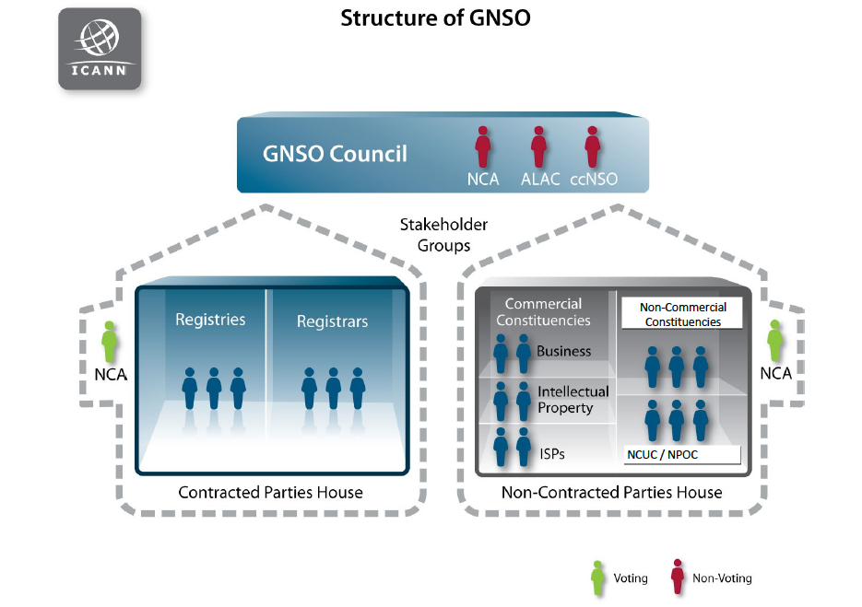

Slide 4
NCSG Constituencies
Noncommercial Users Constituency (NCUC)
The NCUC advocates positions on domain name-related policies that protect and support non-commercial communication and activity on the Internet.
Not-for-profit Operational Concerns Constituency (NPOC)
NPOC focuses on the impact of DNS policies on the operational readiness and implementation of non-commercial missions and objectives.

Slide 5
What do we do at NCSG? NCSG values?
We protect freedom of speech in domain name policy by:
- Preventing intellectual property interests and government overreach when it comes to generic domain names
- Preventing ICANN from becoming a content regulator (for example by requiring registries and registrars to take down content)
Keeping the definition of DNS abuse to a technical definition so ICANN does not become a content regulator (copyright lawyers argue copyright infringement is DNS abuse, which is false)
Privacy
- Bringing privacy to WHOIS (we are on the side of privacy protection not open WHOIS)
Global Access to Domain Names
Human Rights protections in general

Slide 6
What is outside NCSG's remit?
Internet access
Development issues that are not related to Domain Name Policy
Internet governance issues that do not directly relate to domain name policy

Slide 7
How we bring our values in ICANN policy processes?
Elected 6 members of the GNSO council
- Through the GNSO Non-Contracted Parties House (NCPH) elect 1 Director to the ICANN Board
NCUC/NPOC members get involved in Policy Development Processes
Monitoring ICANN activities/statements
Writing public comments and statements
Informing people about our work, why they should join by organizing:
Outreach events during regular ICANN meetings
Outreach events at various Internet governance conferences

Slide 8
Policy and Other Groups, Key Words
ICANN meetings can be confusing so use these tips to find your way:
Look for GNSO Council meetings (we belong to GNSO, we can observe their work and discussions).
Look for the acronym “PDP” if you want to attend policy development sessions. PDPs are created by the GNSO, open to everyone but the final policy outcome will need to be voted on by GNSO council members.
Look for the acronym “CCWG” if you want to attend sessions that discuss issues that are not PDP issues but issues that all the groups at ICANN have chartered to work on, for example accountability of ICANN or ICANN in Internet Governance.
Cross Community session or “CC” are more of a debate and conversation sessions. Policy decisions will not be taken there. They are normally based on topics of CCWGs or PDPs.

Slide 9
What are we going to do at ICANN 62?
ICANN 62 is important to NCSG because:
1. GDPR and WHOIS: Many important discussions will take place about access to domain name registrants personal data. We want to keep this access limited and in compliance with data protection laws.
2. Discussions about geographic top level domain names and who can apply to register them and under what conditions? (Should governments be able to claim all geographic names, even the ones that also have a generic meaning?)
3. We will have discussions regarding convening an Expedited Policy Development Process (EPDP) which will make policies that relate to domain name registrants personal data.
WHOIS and compliance with data protection laws are important, try to attend as many sessions as you can about this topic.

Slide 10
Our Outreach and Capacity Building Efforts
NCSG Policy Capacity Building program
- Face-to-face meeting for registered participants, June 24 (closed meeting)
- The course will enable NCSG members to understand NCSG values and be able to infuse them into policy processes of ICANN
- The F2F meeting is one part of the course and will be recorded and the material used for creating the online course on ICANN Learn
Almost every morning the GNSO will hold a morning briefing on policy issues to be discussed that day. Recommended to attend if you want to have a better grasp of what is going on in the day’s sessions.
NCSG outreach will be held in collaboration with At-Large on 26 June. An informative session where you will understand the different roles of NCSG and At-Large, and how the two NCSG constituencies work and what are their differences.

Slide 11
NCSG special meetings: Board members & contracted parties
Meetings with GNSO Appointed Board Members and the Contracted Party House (registries and registrars):
We will meet with members of the ICANN Board to discuss their plans that could affect domain name registrants privacy. We will also tell them about NCSG’s various capacity building efforts and successes in getting involved with policy at ICANN.
We will meet with the Contracted Party House (the generic name registries and the registrars that register domain names)
- We will discuss privacy of domain name registrants
- Aspects of DNS abuse and their work in this regard and if any ICANN program would require them to regulate content
- Their priorities are in the next year?

Slide 12
GNSO: NCSG - Policy Committee at ICANN62
Discussions about GNSO Council meetings
Temporary specification : “This Temporary Specification for gTLD Registration Data (Temporary Specification) establishes temporary requirements to allow ICANN and gTLD registry operators and registrars to continue to comply with existing ICANN contractual requirements and community-developed policies in light of the GDPR.” This spec contractually obliges registries and registrars to take actions that directly affect the privacy of domain name registration (read about it here: https://www.icann.org/resources/pages/gtld-registration-data-specs-en)
Other PDPs progress
AOB

Slide 13
Other community meetings to attend
Attend other advisory committee and supporting organization meetings:
- To learn about their points of view, which might be opposed to NCSG, and understand them better.
- Forge alliances with groups that have similar points of view.
- Governments (their group is called GAC) do not normally have the same position as NCSG when it comes to privacy or geographic names. It would be good to attend their meetings when they discuss such issues. For example they will discuss GDPR (privacy related) on 25 June from 11-12, 26 June at 8.45. These are marked in the calendar. Note, closed meetings are marked with C. You can’t attend closed meetings unless you are a member.
- GAC: New gTLD Subsequent Procedures WT1-5 (incl. GAC Geographic Names WG) Discussion
- ALAC and GAC meeting: An open meeting, would be good to know where ALAC stands on the issues of GDPR and Geographic Names

Slide 14
NPOC and NCUC meetings
Both NPOC and NCUC will have members sessions which you can attend. Their agenda is on ICANN sched.
Joan (NPOC Chair)
Renata (NCUC Chair)

Slide 15
GAC and GNSO
Johan Julf Helsingius, the GNSO liaison to GAC and NCSG member will be there
1. Intro on GNSO and the PDP 2. Discussion on the ICANN Temporary Specification for GDPR Compliance. 3. Update on GNSO PDP on New gTLD Subsequent Procedures: Work Tracks 1-4 and Work Track 5. 4. GNSO PDP3.0 possible incremental improvements to PDPs. 5. ICANN Budget in the context of stabilizing revenues.

Slide 16
Important Cross Community Sessions
Cross community sessions are not policy development (PDP) groups as such, but all the community groups (governments, end users, noncommercial stakeholders and others) will get together to discuss the important policy issues. You can learn a lot by attending these meetings. Some of the most important ones are:
Cross-Community Session: Geographic Names at the Top-Level (Session 1 and 2)
Cross-Community Session: WHOIS/RDS Policy: Post-GDPR Development and Next Steps (session 1 and 2)

Slide 17
NCSG Strategic Outlook /Trends
This is a joint effort between the ICANN organization, the community and the Board to engage in a discussion on what the NCSG sees as emerging trends in three broad areas:
- trends affecting the broader ICANN ecosystem (including stakeholders, the industry, other issues);
- ICANN organization/operations;
- the broader geo-political environment.
The ICANN Multistakeholder Support and Strategic Initiatives (MSSI) Team will present the twelve trends identified by the organization in 2017 as a basis for discussion.
By the end of this brainstorming exercise, the group shall seek to reach consensus on five top priority trends to help inform ICANN on strategic and operational planning and work prioritization.

Slide 18
Attend GNSO Webinar on Monday 18 June
Know more about PDPs
Know more about GNSO
https://gnso.icann.org/en/announcements/announcement-18jun18-en.htm
Read this document to be more prepared, it is 44 pages of joy! https://gnso.icann.org/sites/default/files/file/field-file-attach/policy-briefing-icann62-05jun18-en.pdf

