Slide 1
NCUC – Newcomers Webinar
24 February 2017 | 1600 UTC

Slide 2
What is NCUC?
A History
Once upon a time, the Noncommercial users didn’t have a space to fight for their rights, related to domain names.
What rights? We will tell you.
But now we have a space to fight for noncommercial users’ rights, that is called NCUC: welcome ☺

Slide 3
Where is NCUC in ICANN Governance System?
We are a constituency
Our overarching Stakeholder Group is Noncommercial Stakeholder Group (NCSG). That is why you had to first apply for NCSG. Remember that complicated form ☺
We contribute to ICANN policy through various ways, mainly:
Policy statements
Policy making groups
Run for elections and become Councilors at the Generic Name Supporting Organization (GNSO) Council.
What is GNSO? GNSO council approves policies. It’s like a parliament. All the contradicting parties live there. But we manage.

Slide 4
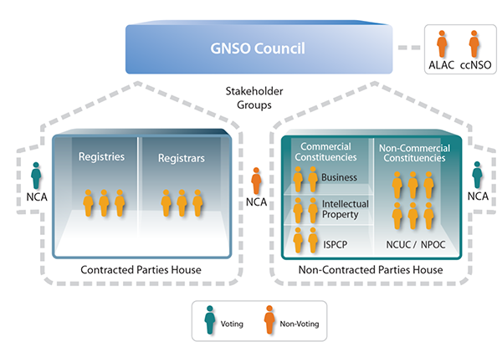
Find NCUC
One day, you can be our councilor, isn’t that exciting?

Slide 5
Navigating the ICANN Maze
Always have ICANN mandate in mind: policy regarding domain system.
We will send you a questionnaire about your skills and background. Please fill that in. If you already know what you want to work on, then contact one of our focal points or your Executive Committee rep (last slide).
Join the working group of your choice or an activity you like. You can read GNSO policy briefs and choose a topic: https://gnso.icann.org/en/issues/background-briefing-27oct16-en.pdf
Attend NCSG Policy Meetings – this takes place monthly, usually on the Tuesday before the GNSO Council Meeting on Thursday.

Slide 6
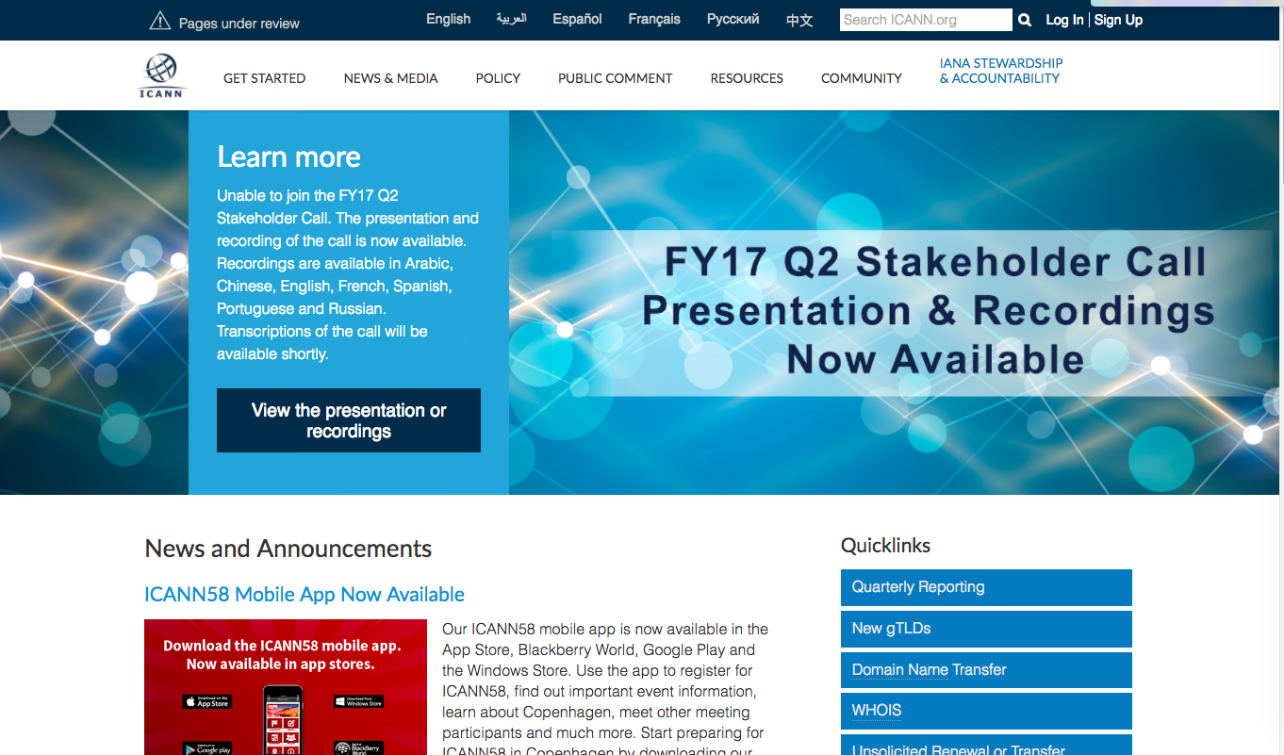
Navigating the ICANN.org Website

Slide 7
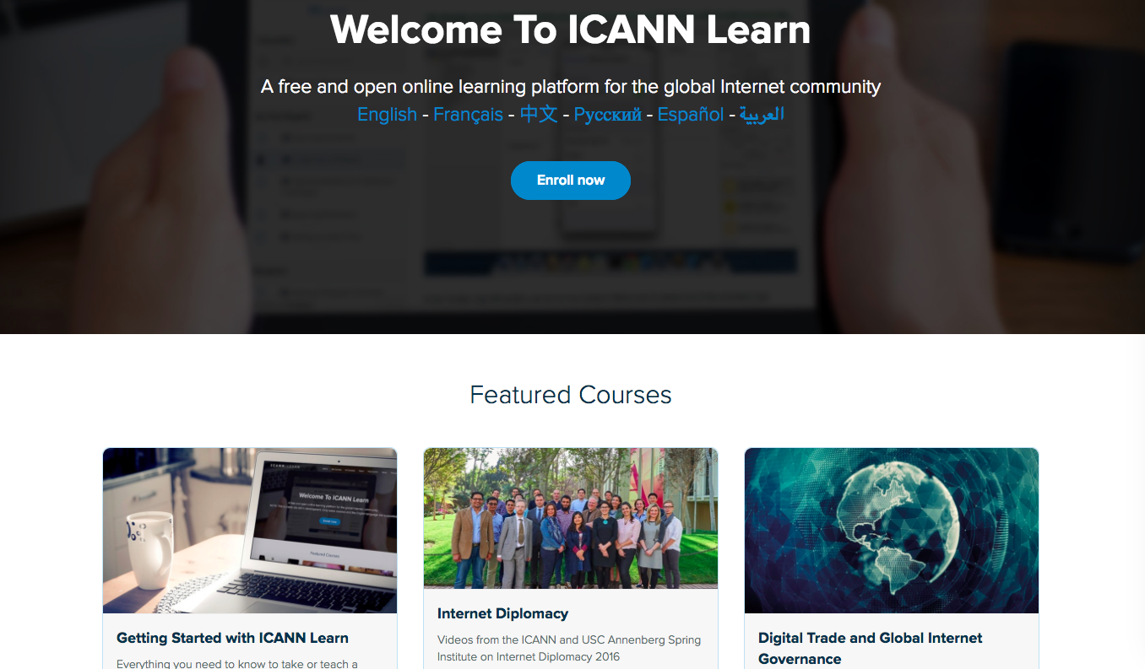
Navigating the ICANN Website – ICANN Learn

Slide 8
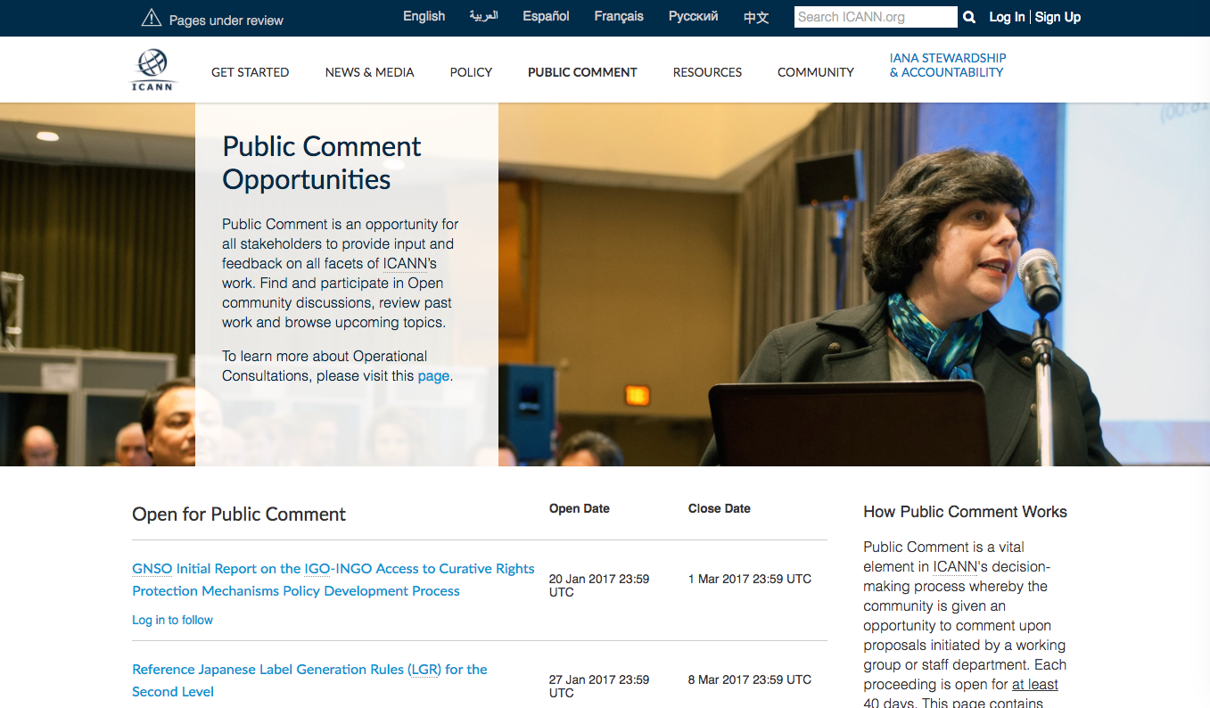
Navigating the ICANN Website – Public Comments

Slide 9
What do we do at NCUC?
Our work has three parts:
First Part: We help make policies related to generic domain names, and during that we advance the issues below:
Freedom of Expression/ Access to Knowledge
Privacy and Data Protection
Human Rights
Discuss Internet Governance
Development and many more
Second Part: We fix ICANN as a corporation! We help ICANN to be more transparent and accountable.
Third Part: We work on enhancing NCUC governance mechanism

Slide 10
Topics NCUC Work on
Access to knowledge/Freedom of Expression and trademarks
Tension between freedom of expression and trademark rights
Seeking balance in domain policy and dispute resolution
Privacy, ICANN and WHOIS
Concern - treatment of registrant data (those that register www.example.com )
You can recommend privacy protections
You can engage with discussions on data protection regulations
Notes:
Access to knowledge and trademarks: Since the early days of ICANN, civil society groups have focused on the tension between freedom of expression and trademark rights. In domain names this manifests itself when people want to register what somebody else would consider to be their trademark in a domain name. The domain name might be used in ways that have nothing to do with the trademark. Yet trademark owners of course want to protect their marks. Seeking to find a balance in domain policy and dispute resolution has been an important part of civil society's work in ICANN. Particularly the development of the Uniform Domain Name Resolution process (UDRP), the Uniform Rapid Suspension policy (URS), and the new gTLD program.

Slide 11
Accountability Issues
Cross Community Working Group (CCWG) On Enhancing ICANN Accountability - two work Streams:
WS1: mechanisms to complete the IANA Stewardship Transition.
WS2: accountability topics that extend beyond the IANA Stewardship Transition: Diversity, Guidelines for Good Faith Conduct, Human Rights, Jurisdiction, Ombudsman, SO/AC Accountability, Staff Accountability, Transparency.
How to get involved?
Join the subgroups dealing with particular topic as a member or an observer
Help us to draft public comments to the subgroup reports (all the subgroups have different timelines)

Slide 12
Getting Involved: NCUC Bylaws & Procedures
A great way to get involved is to work with the Procedures Task Force and Bylaws Process!
The Procedures Task Force meets weekly, but you can also follow along with the Google Doc:
https://docs.google.com/document/d/1b-GyV4FQdIZ8MIWiKVznSsxlb-_z7GQCZotf1g_wosk/edit?usp=sharing
The new bylaws work will be beginning soon!

Slide 13
ICANN 58 Copenhagen
A good opportunity to get involved: what to expect, what to attend on-site and remotely
Find the ICANN Schedule here: https://schedule.icann.org/
NCUC Outreach (will cover all of the hot topics)
NCUC Constituency day
Possible meeting with the CEO to discuss human rights
Meeting with the Board members to tell them about NCUC
Newcomers segment on what NCUC does
Public Forum: Get the Mic and say whatever you want to the Board

Slide 14
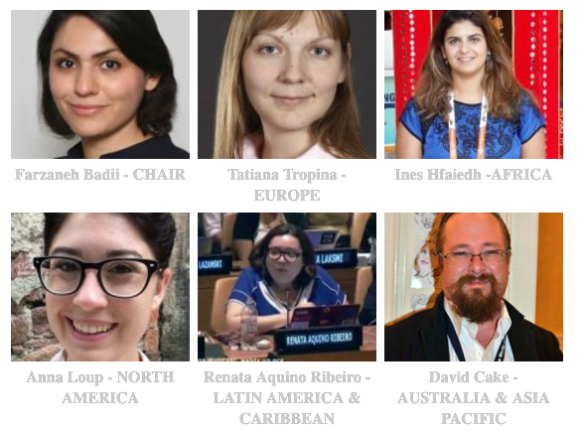
Your Executive Committee Reps and Points of contact
www.ncuc.org/governance/executive-committee/
Regions: Europe, Asia Pacific, North America, LAC, Africa
You are already on the regional mailing list, contact your EC members through that list or ask Maryam at maryam.bakoshi@icann.org to put you in touch.

Slide 15
Thank You!
Website: http://www.ncuc.org/
Twitter: @NCUC
Contact: ncuc@ncuc.org
Join: http://www.ncuc.org/join
Notes:
NCUC Issues
* Protecting Noncommercial Uses and Users -- seek to ensure commercial interests do not override the interests of nonprofits and ordinary users
* Diversity and Consumer Choice -- support a competitive domain name industry that offers Internet users innovation, quality options and affordable prices
* Human Rights -- promote an approach to domain name policy that is consistent with internationally recognized human rights
* Freedom of Expression -- challenge efforts to abuse the core of the Internet by censoring expression and regulating content
* Privacy -- oppose efforts to use domain registration records for indiscriminate surveillance
* Access to Knowledge -- advocate for protection of the global public sphere against the excessive application of intellectual property restrictions
* Development -- work for policies that promote socio- economic growth and development in all areas of the world
* Multilingual Internet -- support standards and practices that allow all cultures and linguistic groups to be represented in the domain name space
* Global Internet Governance -- We strive to make governance institutions accountable, promote multistakeholder participation

