Slide 1
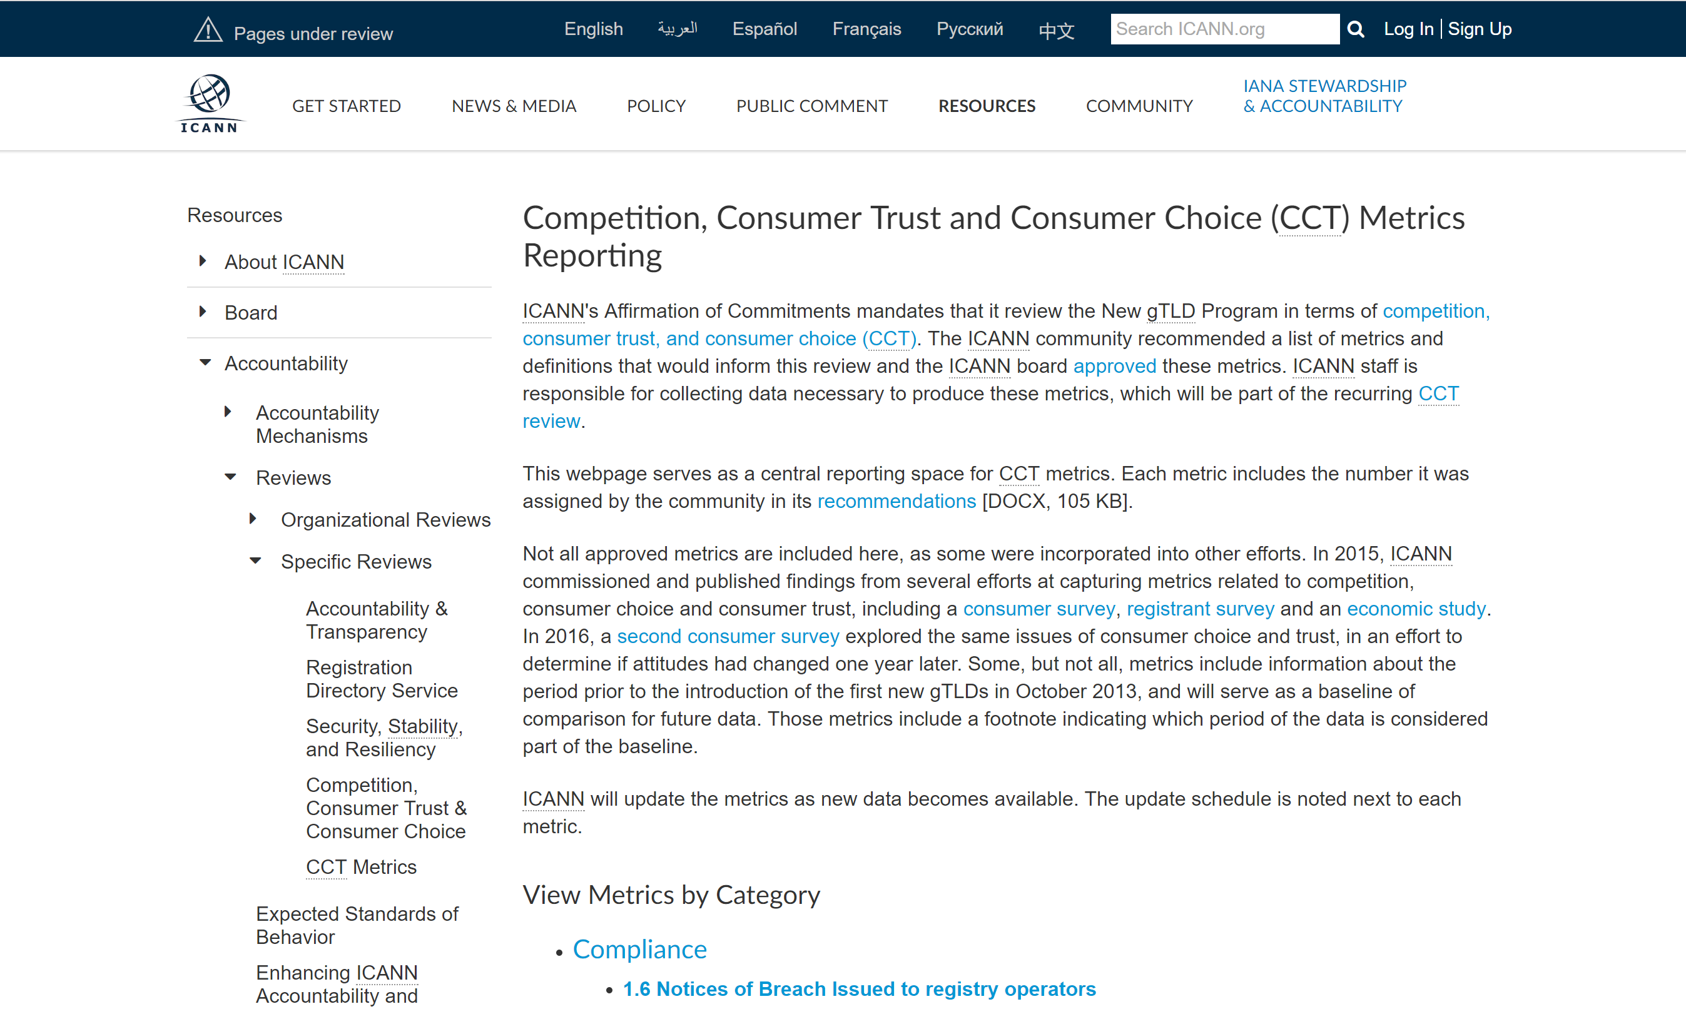
Navigating the ICANN Website

Slide 2
Getting Involved: Bylaws & Procedures
A great way to get involved is to work with the Procedures Task Force and Bylaws Process!
The Procedures Task Force meets weekly, but you can also follow along with the Google Doc:
https://docs.google.com/document/d/1b-GyV4FQdIZ8MIWiKVznSsxlb-_z7GQCZotf1g_wosk/edit?usp=sharing
The new bylaws work will be beginning soon!

