Slide 1
Update on Evolving Organizational Reviews into a Continuous Improvement Program
Non Commercial Users Constituency input on the draft Continuous Improvement Program Framework in progress by the CIP-CCG
Benjamin Akinmoyeje / Liubomir Nikiforov of CIP-CCG representative and alternate]
Virtual (Zoom) - June 2024

Slide 2
Purpose of today’s presentation
As per the Terms of Reference (TOR) for the CIP-CCG, “the representatives in the CIP-CCG will share best practices and collaborate on community-wide implementation of ATRT3 Recommendation 3.6, while relaying information back to their constituencies to inform the process and voice decisions”.
It is important for the community to develop a shared understanding of the CIP framework being developed by the CIP-CCG, and the goal of this presentation is threefold:
Education: Educate the community on the Principles, Criteria, Indicators framework.
Questions: Answer questions about the framework.
Feedback: Invite input on the criteria and indicators.

Slide 3
ATRT3 Recommendation 3.6: Evolving Organizational Reviews
The Third Accountability and Transparency Review (ATRT3) Recommendation 3.6 calls for the evolution of Organizational Reviews conducted by an Independent Examiner into a Continuous Improvement Program (CIP) led by the ICANN community. The Board deferred upcoming Organizational Reviews until 2025 so that this recommendation and others from ATRT3 could be implemented.
The ICANN community demonstrated great interest in contributing to the evolution of Organizational Reviews into a CIP, with 21 out of 22 of the groups across the ICANN community represented in a Continuous Improvement Program Community Coordination Group (CIP-CCG) which convened in January 2024.
The CIP-CCG is tasked with developing a framework for the CIP, which will be published for Public Comment prior to adoption by each SO, AC, and the NomCom.
The CIP will include a regular survey of members/participants for assessment, utilizing the framework.

Slide 4
CIP-CCG Roadmap (2024)
ICANN81 Prep Week
28-31 Oct (est)
CIP-CCG Webinar
The CIP-CCG finalize principles
5 Jun
The CIP-CCG receive input on Criteria and Indicators
5 Jun - 24 Jul
ICANN81 Annual General Meeting
9-14 Nov
Community and Board socialization of the framework
4 Sept - 16 Oct
ICANN80 Prep Week
28-30 May
APR 2024
MAY 2024
5 JUN 2024
JUL
2024
7 AUG
2024
SEPT
2024
OCT
2024
21 NOV 2024
ICANN80 Policy Forum
10-13 Jun
The CIP-CCG receive input on Principles
3 Apr - 29 May
The CIP-CCG finalize criteria and indicators
7 Aug
CIP Framework
published for
Public Comment*
21 Nov
*The CIP-CCG will address input received and revise the CIP Framework, where relevant.

Slide 5
Phases of CIP-CCG Timeline
Phase 1 (January - March) COMPLETE: The CIP-CCG made substantial progress toward developing principles for the CIP, which provide a common base for the assessment of the different ICANN community structures. The principles stem from Article 4.4 of the ICANN Bylaws describing objectives for Organizational Reviews.
Phase 2 (April) COMPLETE: Community representatives went to their groups to inform them of the progress of the CIP-CCG and their work-to-date, including work the Principles, Criteria, Indicators approach for the draft CIP framework, how the framework will be utilized in the (first) CIP assessment phase. Ongoing CIP-CCG meetings and regular updates from your CIP-CCG representative (and alternate) throughout 2024.
Phase 3 (May, June) IN PROGRESS: Once Community reps have educated their structures on CIP-CCG progress on the Principles, Criteria, Indicators approach and how the process of the CIP will work, they are now organizing working sessions with their community reps in Q2-3 2024 to gather feedback on the Criteria and Indicators for their group. Provide input to your CIP-CCG representative!
Phase 4 (July, August): Finally, community reps work with groups to reach consensus on Criteria and Indicators applicable to their organizational structures (this will occur after iterations of CIP-CCG meetings during Phase 2). Draft CIP Framework will be published for Public Comment (est. Oct/Nov 2024).

Slide 6
Continuous Improvement Program Roadmap
CIP Assessment Period 2
estimated to begin in 2028
Conclude at the end of 2030 (3 years)
Initial development phase of CIP Framework, 12-month estimation, concluding by Dec 2024
Board consideration of CIP pilot and progress made towards evolving Organizational Reviews
NOV 2024
DEC 2024
JAN 2025
FEB-MAY
2025
JUN
2025
DEC
2027
JAN
2028
DEC
2030
CIP Assessment Period 1
estimated to begin upon adoption of the Framework
Conclude at the end of 2027 (3 years)
CIP Framework
published for
Public Comment
The results of the CIP assessments will inform the Holistic Review*
*Subject to community support, Board approval and incorporation into the ICANN Bylaws.

Slide 7
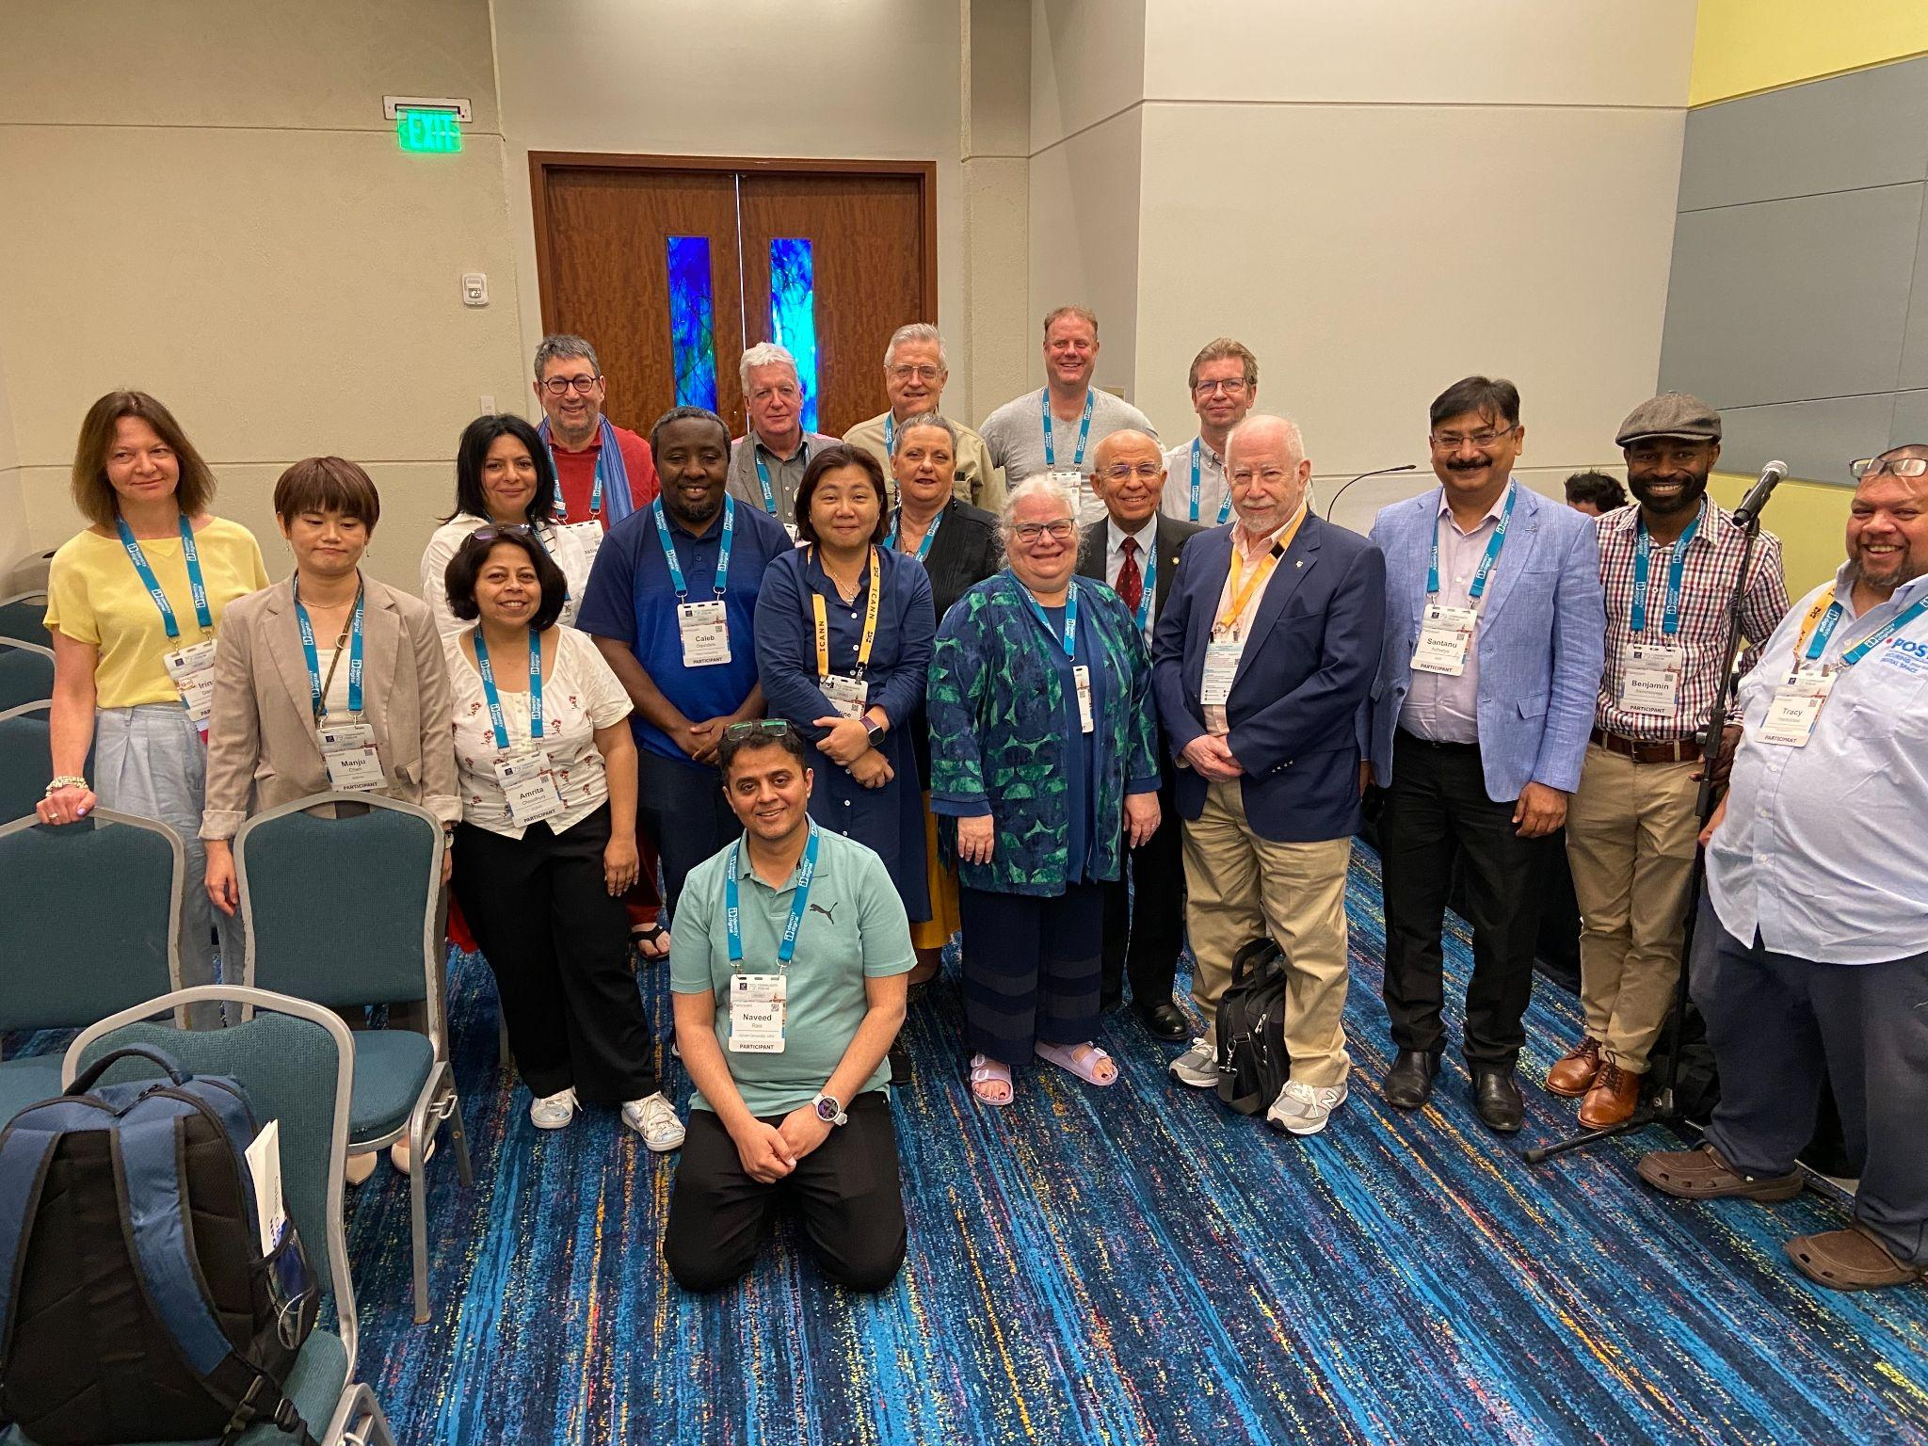
ICANN Community and the CIP-CCG
Pictured: CIP-CCG volunteers during the ICANN79 Community Forum.
CIP-CCG volunteers are sharing best practices and collaborating on community-wide implementation of ATRT3 Rec. 3.6. In work to-date, they have considered a range of methodologies for effective continuous improvement programs, utilizing a Principles-Criteria-Indicators framework fit for ICANN purpose.
CIP-CCG volunteers are drafting the CIP Framework, to be used by each SO, AC, and NomCom, while relaying information back to their groups to inform the process.

Slide 8
Principles / Criteria Framework
Principles / Criteria Framework: consists of principles, criteria, and indicators:
Principles describe the objectives of the Continuous Improvement Program. They define what the CIP is fundamentally trying to do.
Criteria are the conditions that need to be met in order to comply with a principle. Criteria define how a principle will be achieved, without themselves being a measure of performance.
Indicators define what the CIP will measure to assess whether or not criteria are being met. Indicators can include metrics, assessments, and or new processes put in place to meet criteria.

Slide 9
CIP Framework Considerations
Recommendation 3.6 states “ICANN org shall work with each SO/AC/NomCom to establish a continuous improvement program [that shares] a common base between all SOs, ACs, and the NomCom but will also allow for customization so as to best meet the needs of each individual SO/AC/NomCom.

Slide 10
Current Objectives of Organizational Reviews
Source: Article 4.4 of the ICANN Bylaws
(i) whether that organization, council or committee has a continuing purpose in the ICANN structure.
(ii) if so, whether any change in structure or operations is desirable to improve its effectiveness.
(iii) whether that organization, council or committee is accountable to its constituencies, stakeholder groups, organizations and other stakeholders.
Notes:
As noted, these objectives provided by Article 4.4 of the ICANN Bylaws provide the foundation for the shared principles for the community under the new CIP.

Slide 11
ICANN Principles of Continuous Improvement (Draft as of 5 June)
Historically, ICANN Organizational Reviews have asked whether the Supporting Organizations (SOs), Advisory Committees (ACs), and the Nominating Committee (NomCom) have a continuing purpose within the ICANN community. Rather than articulating this as a single principle, it is an overarching consideration that is addressed through five separate principles that would guide the successful execution of the Continuous Improvement Program (CIP):
The SO, AC, or NomCom is fulfilling its purpose.
The operations of SO, AC, or NomCom are effective.
Principle 1
Principle 2
The SO, AC, or NomCom is accountable internally to its stakeholders and substructures (where applicable), and externally to the wider ICANN community.
The operations of SO, AC, or NomCom are efficient.
Principle 3
Principle 4
The SO, AC, or NomCom collaborates to further the mission of ICANN and the effectiveness of the ICANN multistakeholder model.
Principle 5

Slide 12
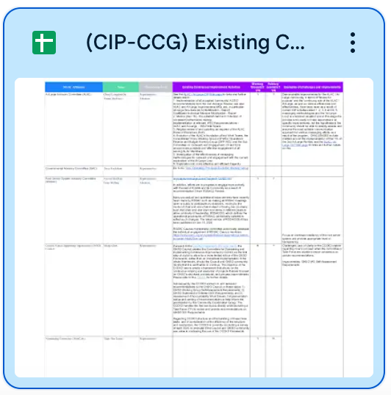
Mapping existing CI and Jamboard content
Principles
Criteria
Indicators (SMART)

Slide 13
Principles to Criteria Example
Example of Principle 3:
The operations of SO, AC, or NomCom are efficient.
Examples of potential Criteria for our community structure/group:
Each structure has a process for planning and setting priorities.
Each structure efficiently assesses inputs related to their scope of responsibility.
Each structure efficiently develops and recommends outputs relevant to their purpose (policy development, support policies, leadership placement).
Each structure’s outputs are implemented efficiently and implementation of outputs is monitored.

Slide 14
Principles to Criteria to Indicators Example
Example of Principle 3:
The operations of SO, AC, or NomCom are efficient.
Examples of potential Criteria for our community structure/group:
Each structure has a process for planning and setting priorities.
Each structure efficiently assesses inputs related to their scope of responsibility.
Each structure efficiently develops and recommends outputs relevant to their purpose (policy development, support policies, leadership placement).
Each structure’s outputs are implemented efficiently and implementation of outputs is monitored.
Examples of potential Indicator for Criteria: “Each structure has a process for planning and setting priorities”.
Yes.
If No, indicator could be to develop a process, that is Specific, Measurable, Achievable, Relevant, and Time-Bound (SMART).

Slide 15
Collaborative Input on Criteria and Indicators
Collaborative meeting with advance homework:
Develop Criteria and Indicators relevant to our structure
Brainstorm based on current continuous improvement activities to form criteria for each SO/AC/NomCom.
5 June - 24 July
(see CIP-CCG roadmap):
The CIP-CCG present to their groups to receive input on Criteria and Indicators applicable to their SOACs, gather feedback for framework in progress.

Slide 16
Criteria for Non Commercial Users Constituency consideration
Resources
Link to our dedicated workspace in the CIP-CCG Google Drive: Many groups already began developing criteria and indicators relevant to their structures. We may leverage our dedicated workspace, or other preferred collaborative tools such as Jamboards.
Link to database of the ICANN community’s existing continuous improvement activities: The objective of the CIP implementation is leverage work that the community is already doing toward continuous improvement, to inform development of the criteria and indicators.

Slide 17
Criteria for Non Commercial Users Constituency consideration
Sample criteria provided to each community group.
Principle 1: The SO, AC, or NomCom is fulfilling its purpose - Draft Criteria
Criteria 1: There is an agreement that the SO, AC, or NomCom is fulfilling its purpose. This may include assessing how each organizational structure contributes to ICANN's mission, “to help ensure a stable, secure, and unified global Internet.” This includes initiatives to advance ICANN’s mission; to combat domain name security threats, produce and offer capacity-building resources, and to expand and build a multilingual Internet.
Criteria 2: How each organizational structure contributes to the global public interest, as described in the ICANN Articles of Incorporation (2016): “in recognition of the fact that the Internet is an international network of networks, owned by no single nation, individual or organization, (ICANN) shall, except as limited by Article IV hereof, pursue the charitable and public purposes of lessening the burdens of government and promoting the global public interest in the operational stability of the Internet by carrying out the mission set forth in the (ICANN Bylaws). Such global public interest may be determined from time to time. Any determination of such global public interest shall be made by the multistakeholder community through an inclusive bottom-up multistakeholder community process.”
Criteria 3: How each organizational structure contributes to the ICANN Strategic Plan (FY21-25) objectives, especially the strategic objective to “Improve the effectiveness of ICANN’s multistakeholder model of governance.”

Slide 18
Criteria for Non Commercial Users Constituency consideration
Sample criteria provided to each community group.
Principle 2: The operations of SO, AC, or NomCom are effective - Draft Criteria
Criteria 1: Each structure has a working group or process to address their goals and priorities each year, in line with their purpose.
Criteria 2: Structures in place are accessible and clearly communicated.
Criteria 3: Structures help each SO, AC, or NomCom operate to meet its purpose.
Criteria 4: Process(es) is (are) in place for planning and prioritizing work.
Criteria 5: Process(es) is (are) in place for assessing and measuring output.
Criteria 6: Output has produced the desired outcome.
Criteria 7: Output is implemented in a timely fashion.

Slide 19
Criteria for Non Commercial Users Constituency consideration
Sample criteria provided to each community group.
Principle 3: The operations of SO, AC, or NomCom are efficient - Draft Criteria
Criteria 1: Each structure has a process for planning and setting priorities, and identifying relevant emerging issues to focus on within established timeframes.
Criteria 2: Each structure assesses inputs related to their scope of responsibility.
Criteria 3: Each structure develops and recommends outputs relevant to their purpose (policy development, support policies, leadership placement).
Criteria 4: Each structure’s outputs are implemented and implementation of outputs is monitored.
Criteria 5: Workloads are managed.
Criteria 6: Each structure nurtures consensus within their constituency.
Criteria 7 : Each structure coordinates with ICANN SOs, ACs, Committees, and constituencies within the ICANN global multistakeholder community.
Criteria 8: There is an agreement that the structure operates efficiently overall.
Criteria 9: Appropriate level of funding support.

Slide 20
Criteria for Non Commercial Users Constituency consideration
Sample criteria provided to each community group.
Principle 4: The SO, AC, or NomCom is accountable internally to its stakeholders and substructures (where applicable), and externally to the wider ICANN community - Draft Criteria
Criteria 1: Adequate representation of the diversity of the global multistakeholder community within group membership and SO, AC, NomCom roles (Guided by ICANN Core Value 4).
Criteria 2: SO, AC, and NomCom objectives align with planned objectives of ICANN as a whole.
Criteria 3: SO, AC, and NomCom is accountable to the wider ICANN community, its organizations, committees, constituencies, and stakeholder groups in recruiting, developing, and maintaining membership needed to achieve its purpose.
Criteria 4: Support and resources for recruiting and onboarding newcomers to the SO, AC, or NomCom.
Criteria 5: Maintaining skill sets and technical expertise needed through capacity building.
Criteria 6: Maintaining effective levels of active participation.
Criteria 7: Each structure maintains sufficient levels of transparency of information.
Criteria 8: Each structure communicates and engages with its constituents and the broader multi-stakeholder community.
Criteria 9: SO, AC, or NomCom has implemented prior review recommendations.
Criteria 10: Processes are in place to assess, prioritize, and implement suggestions for improvement received as outputs from the Continuous Improvement Program.
Criteria 11: There is an agreement that the SO, AC or NomCom is accountable to the wider ICANN community, its organizations, committees, constituencies, and stakeholder groups.

Slide 21
Criteria for Non Commercial Users Constituency consideration
Sample criteria provided to each community group.
Principle 5: The SO, AC, or NomCom collaborates to further the mission of ICANN and the effectiveness of the ICANN multistakeholder model - Draft Criteria
Criteria 1: The organizational structures have a process in place for communicating and coordinating within the ICANN global multistakeholder community.
Criteria 2: The organizational structure meets regularly with the ICANN Board.
Criteria 3: The SOAC Leadership Roundtables and meetings are organized at each ICANN Meeting, and help to improve overall communication, setting priorities, and planning.

Slide 22
Question for Non Commercial Users Constituency consideration
Do you feel comfortable with the criteria and indicators developed by your CIP-CCG representative and alternate in consultation with our structure/group, to allow for customization so as to best meet the needs of each individual SO, AC, NomCom and its substructures (where applicable)?
Note from ATRT3 Report, p.73: “For SOs and ACs that are composed of substructures, this should apply to their individual substructures and the results of all sub-structures shall be aggregated to generate a result for the given SO or AC.”

Slide 23
Resources: Please Read and Share!
Continuous Improvement Program Home: https://community.icann.org/display/CIP
Continuous Improvement Program Community Coordination Group (CIP-CCG) Meetings
CIP-CCG Resources
CIP-CCG Membership and Mailing List
ICANN Continuous Improvement Program Makes Progress on a Draft Framework: March 2024
ICANN Launches the Continuous Improvement Program Community Coordination Group: January 2024
ICANN Reviews Program Update: February 2024
ICANN Reviews Program Update and Interim President and CEO Goal 11: October 2023

